Slide 1
Flex box
Front end web development

Slide 2
Why use flexbox
Flexbox makes layout design easier by providing:
Simple horizontal and vertical alignment
Flexible spacing between elements
Responsive design support
Cleaner and shorter CSS code

Slide 3
FLEX ITEM PROPERTIES
These control individual item behavior:
flex-grow → item expands to fill space
flex-shrink → item shrinks if needed
flex-basis → starting size
order → changes item order

Slide 4
adVANTAGES OF FLEX BOX
✔ Easy alignment
✔ Responsive layouts
✔ Less complex code
✔ Better spacing control

Slide 5
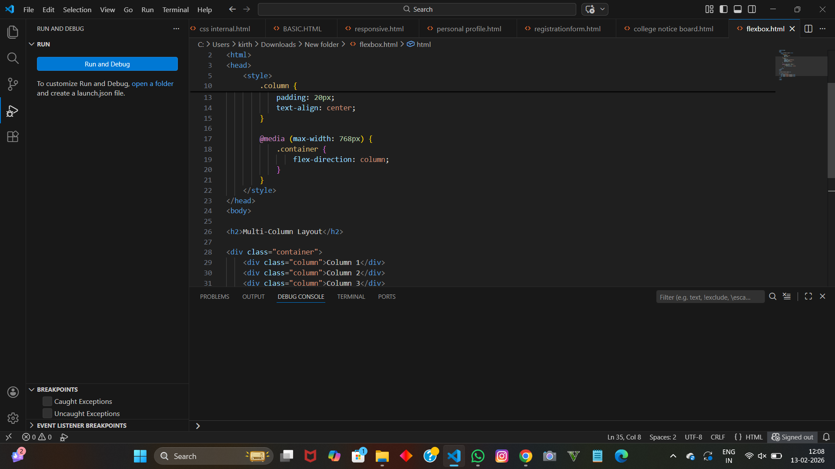
code

Slide 6
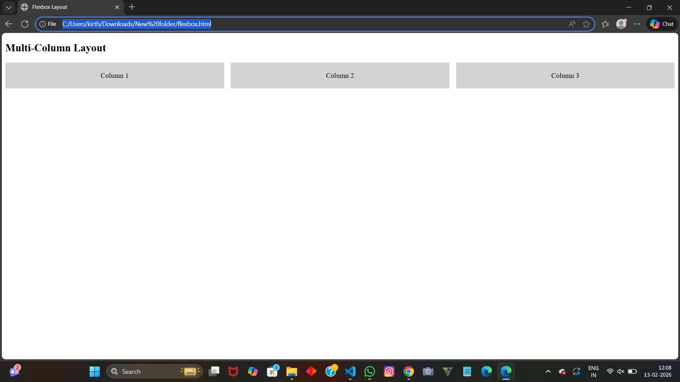
OUTPUT

